Slide 1
Modern Migration Issues in Human Geography
John Kostelnick
Illinois State University
Kevin Suess
Normal Community High School
Illinois Geographic Alliance Spring Conference:
AP Human Geography
April 6, 2013
Stevenson High School, Lincolnshire, IL
Notes:
Kevin and John

Slide 2
Overview
Migration in Recent APHG Exam FRQs
Current Migration Streams
Current Forced Migration and Refugee Crises
Current U.S. Immigration Policy
Notes:
Kevin and John

Slide 3
Key Questions
Where are migrants coming from and where are they going?
Who is migrating and why?
Does government policy or intervention factor into the migration and, if so, how?
What impact does the migration have?
Notes:
Kevin and John

Slide 4
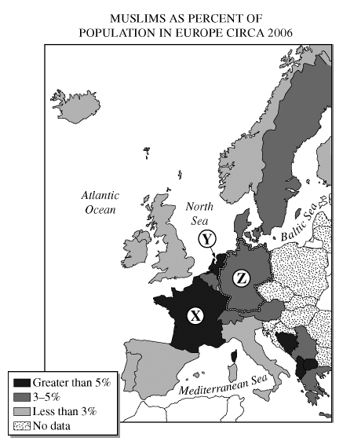
Migration in Recent APHG EXAM FRQs
Notes:
Kevin and John

Slide 5
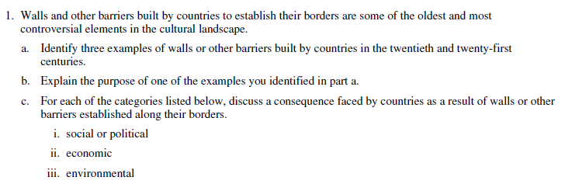
Migration in Recent APHG EXAM FRQs
Notes:
Kevin and John

Slide 6
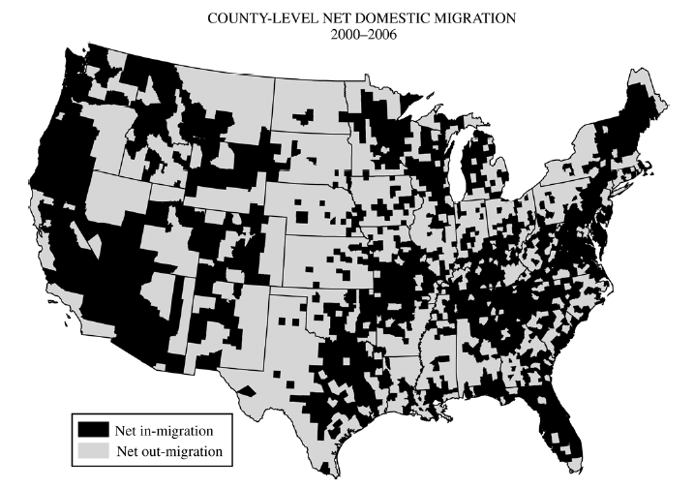
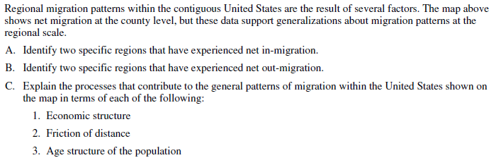
Migration in Recent APHG EXAM FRQs
Notes:
Kevin and John

Slide 7
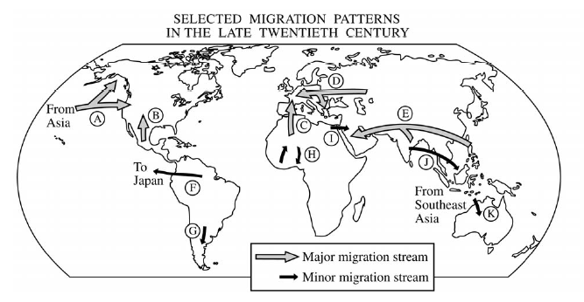
Migration in Recent APHG EXAM FRQs
Notes:
Kevin and John

Slide 8
Current Migration Streams

Slide 9
Current migration streams
CIA
Estimates (2012)
(Net Immigration)
https://www.cia.gov/library/publications/the-world-factbook/rankorder/2112rank.html
Notes:
John

Slide 10
Current migration streams
CIA
Estimates (2012)
(Net Emigration)
https://www.cia.gov/library/publications/the-world-factbook/rankorder/2112rank.html
Notes:
John

Slide 11
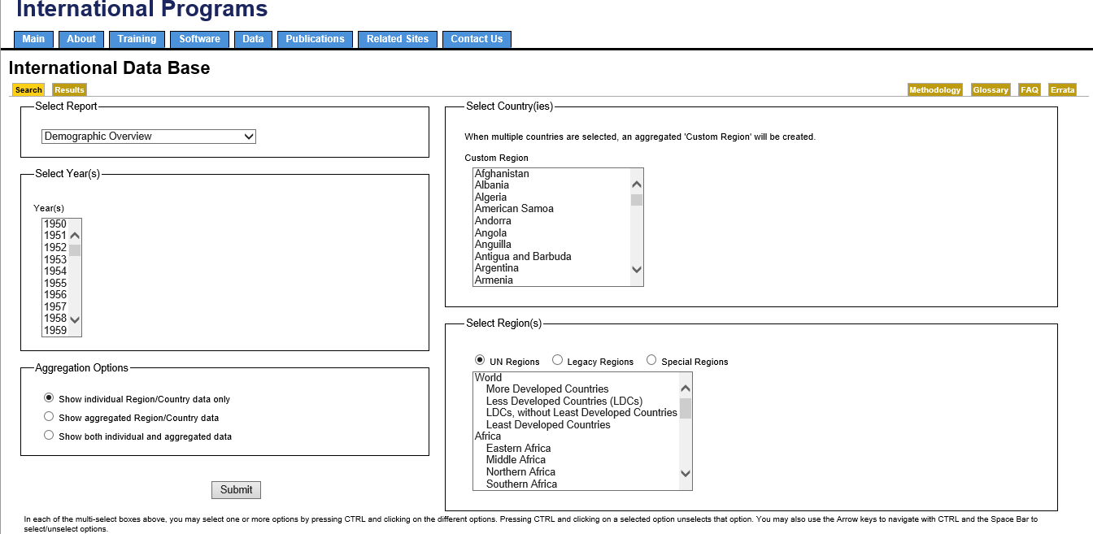
Current migration streams
http://www.census.gov/population/international/data/idb/informationGateway.php
Notes:
John

Slide 12
Current migration streams
Notes:
John

Slide 13
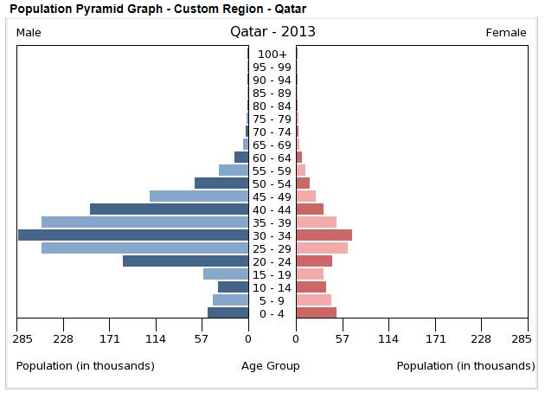
Current migration streams
Population pyramid for Qatar
Notes:
John

Slide 14
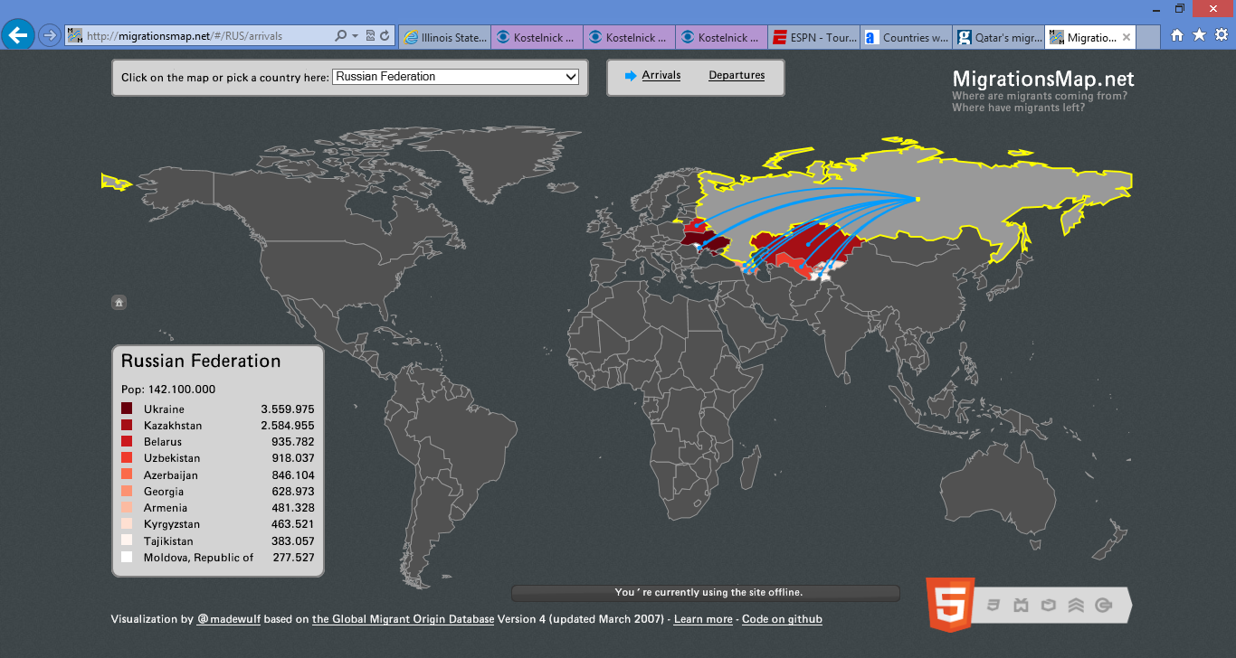
Current migration streams
http://migrationsmap.net/#/TUR/departures
Notes:
John

Slide 15
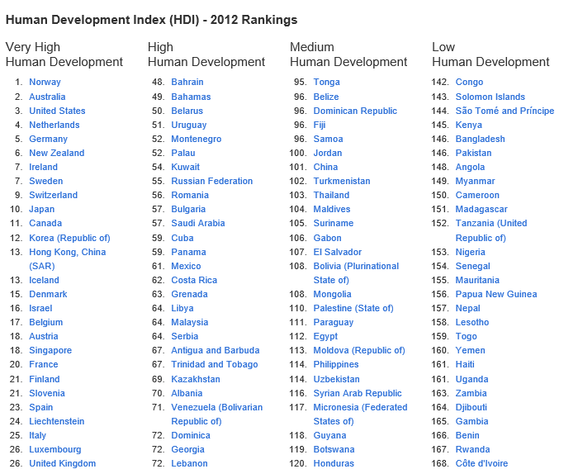
Explaining migration streams
http://hdr.undp.org/en/statistics/
Notes:
John

Slide 16
Current Migration Streams
Explaining migration streams
http://www.foreignpolicy.com/failed_states_index_2012_interactive
Notes:
John

Slide 17
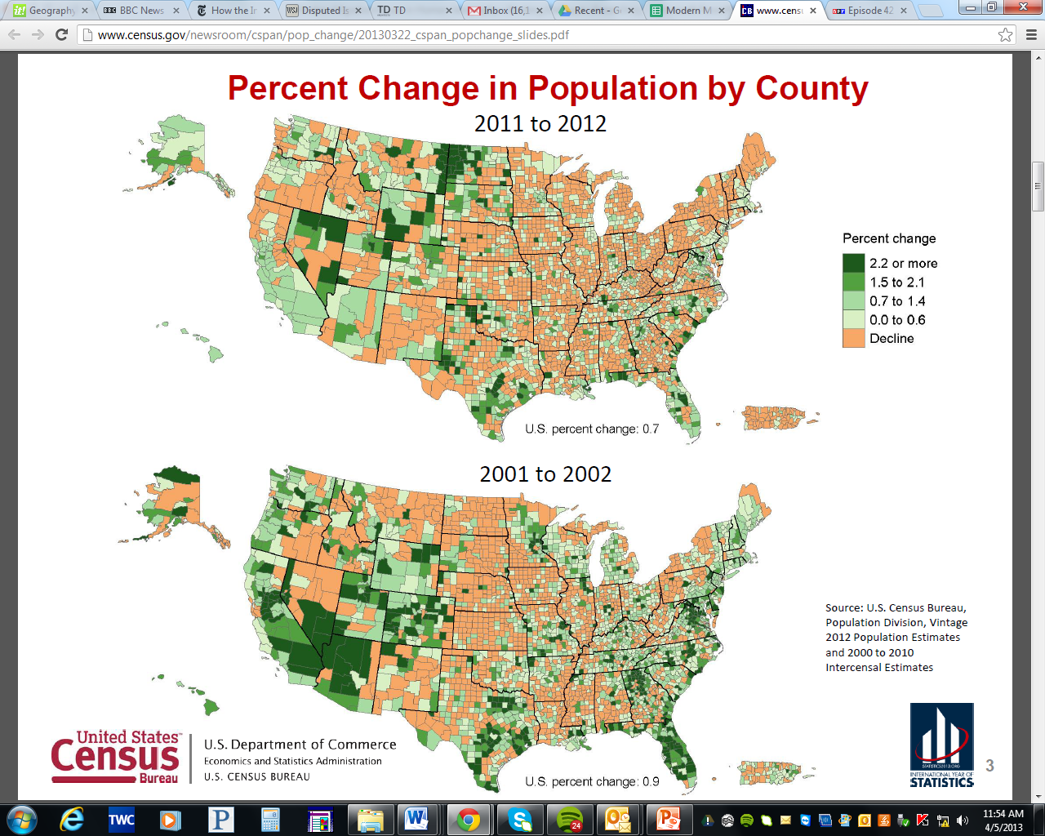
Current migration streams
Internal U.S. Migration and Population Change
http://www.census.gov/newsroom/cspan/pop_change/20130322_cspan_popchange_slides.pdf
Notes:
Kevin

Slide 18
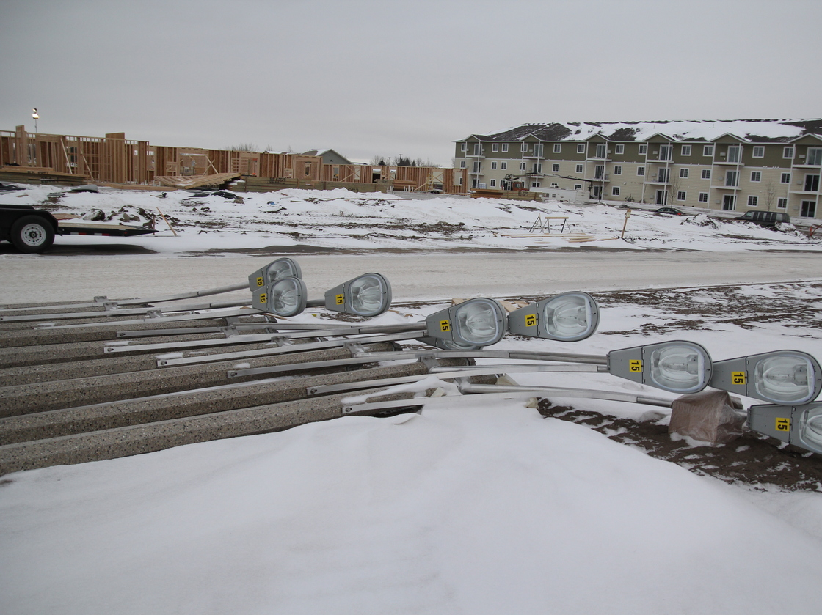
Coming soon: A town.

Slide 19
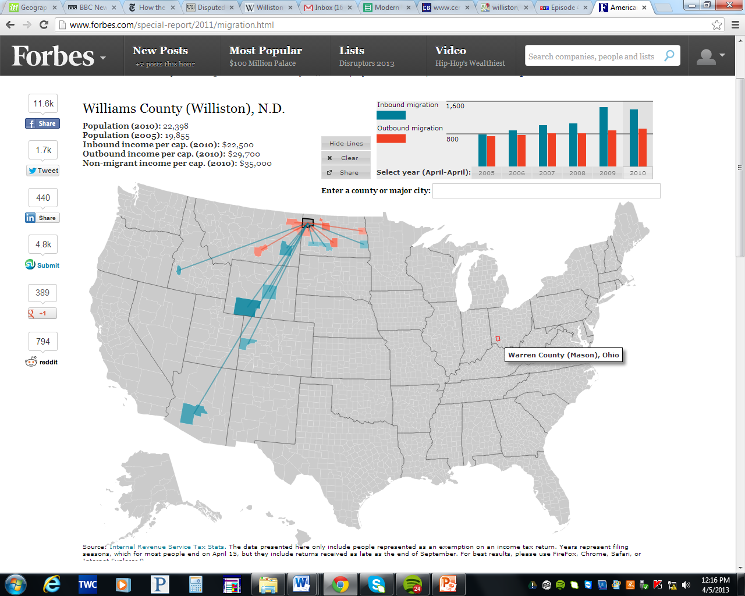
Forbes Interactive Migration Map of U.S.

Slide 20
CurrenT Refugee Crises

Slide 21
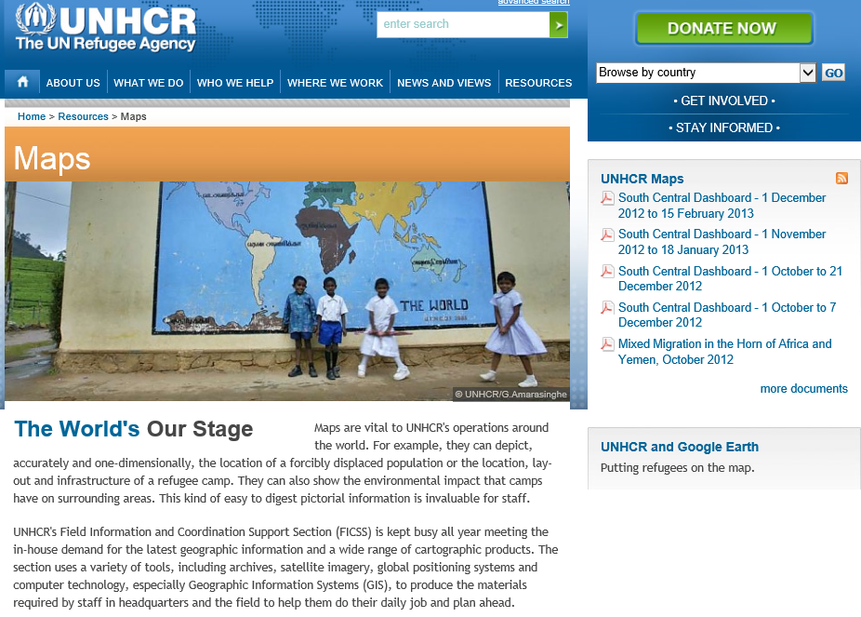
Current Refugee Crises
http://www.unhcr.org/pages/49c3646c4ca.html
Notes:
John

Slide 22
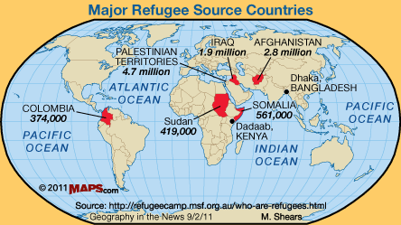
Current Refugee Crises
Notes:
Kevin

Slide 23
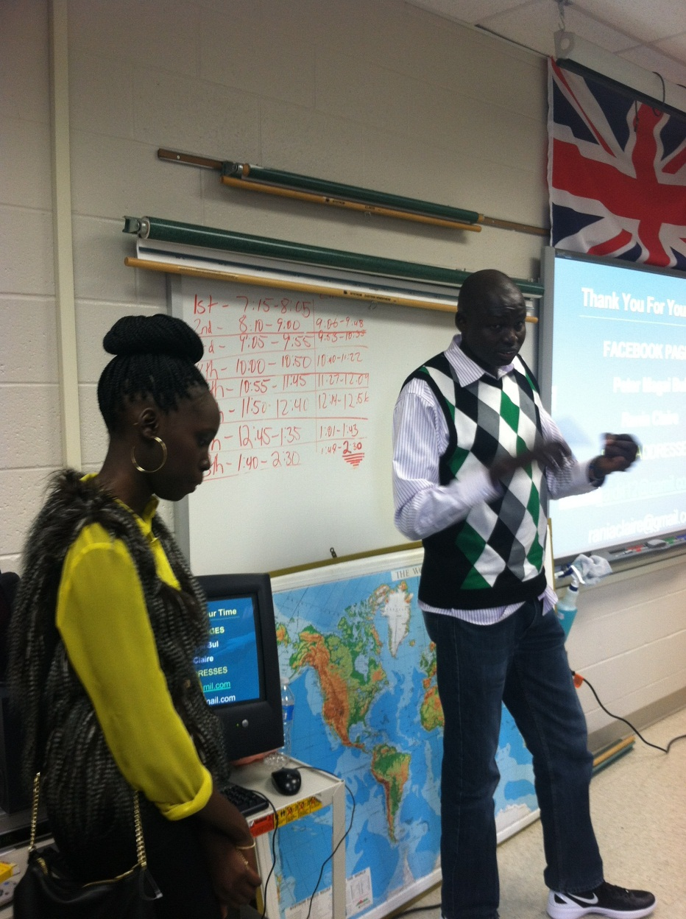
Making the human connection to refugee crises
http://sudaneseofillinois.org/

Slide 24
http://education.nationalgeographic.com/education/god-grew-tired-of-us-education/?ar_a=1

Slide 25
Refugee Crises and Twitter
https://twitter.com/Refugees
Notes:
Kevin

Slide 26
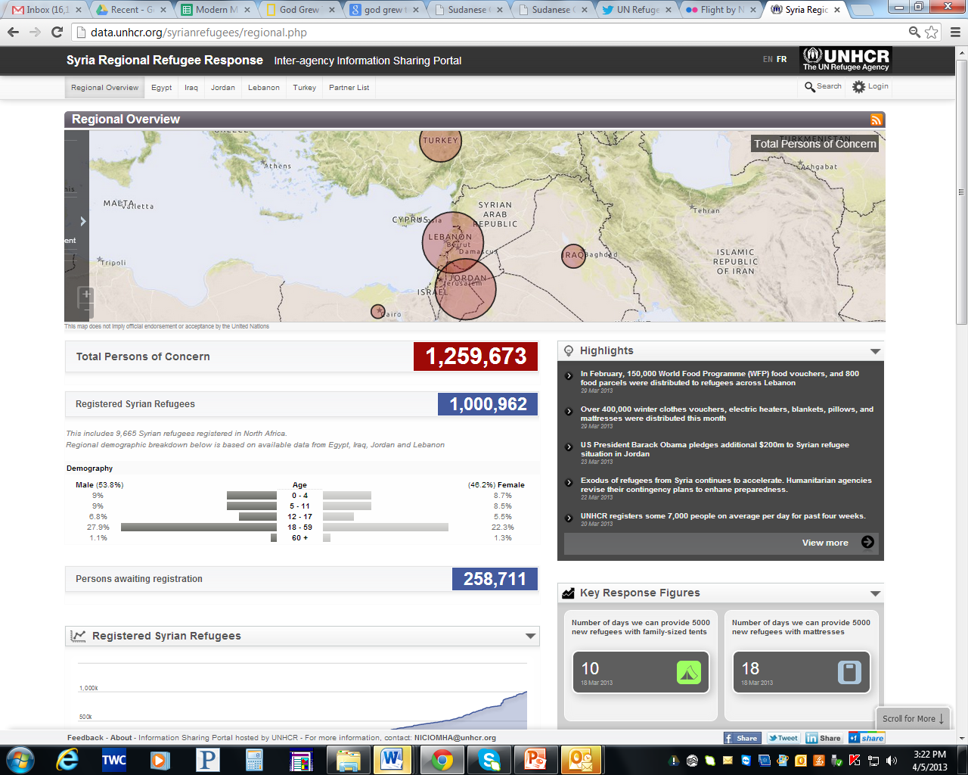
Syria Regional Refugee Response
http://data.unhcr.org/syrianrefugees/regional.php

Slide 27
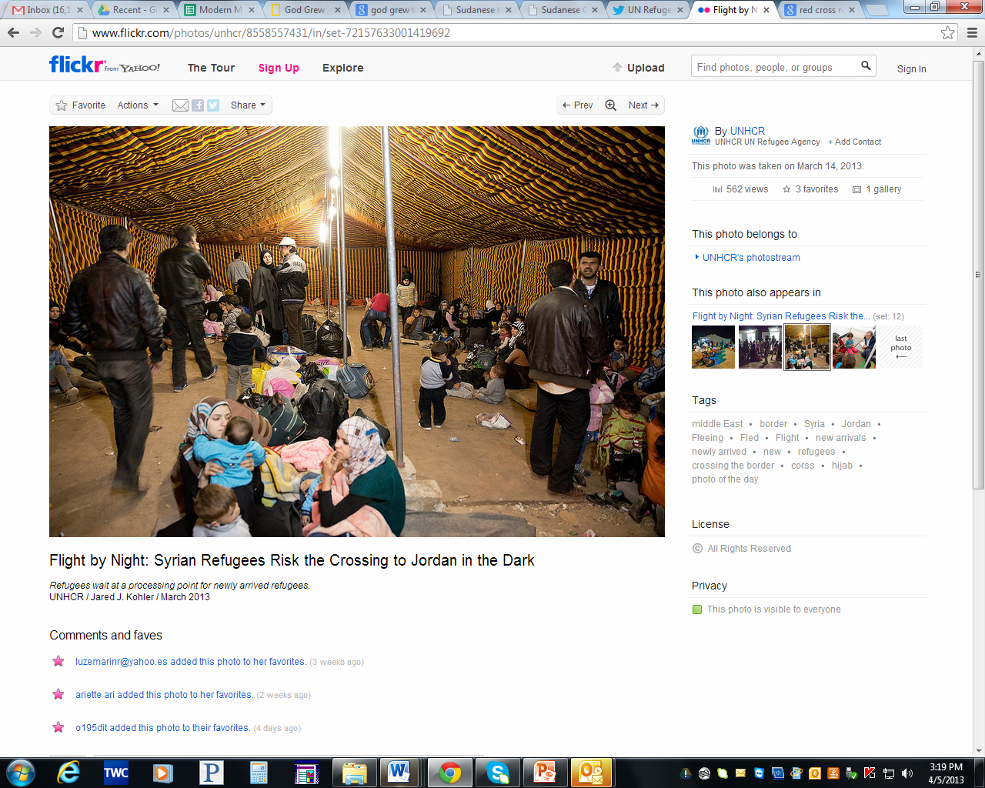
UNHCR and Flickr
http://www.flickr.com/photos/unhcr/sets/72157633001419692/with/8558557431/

Slide 28
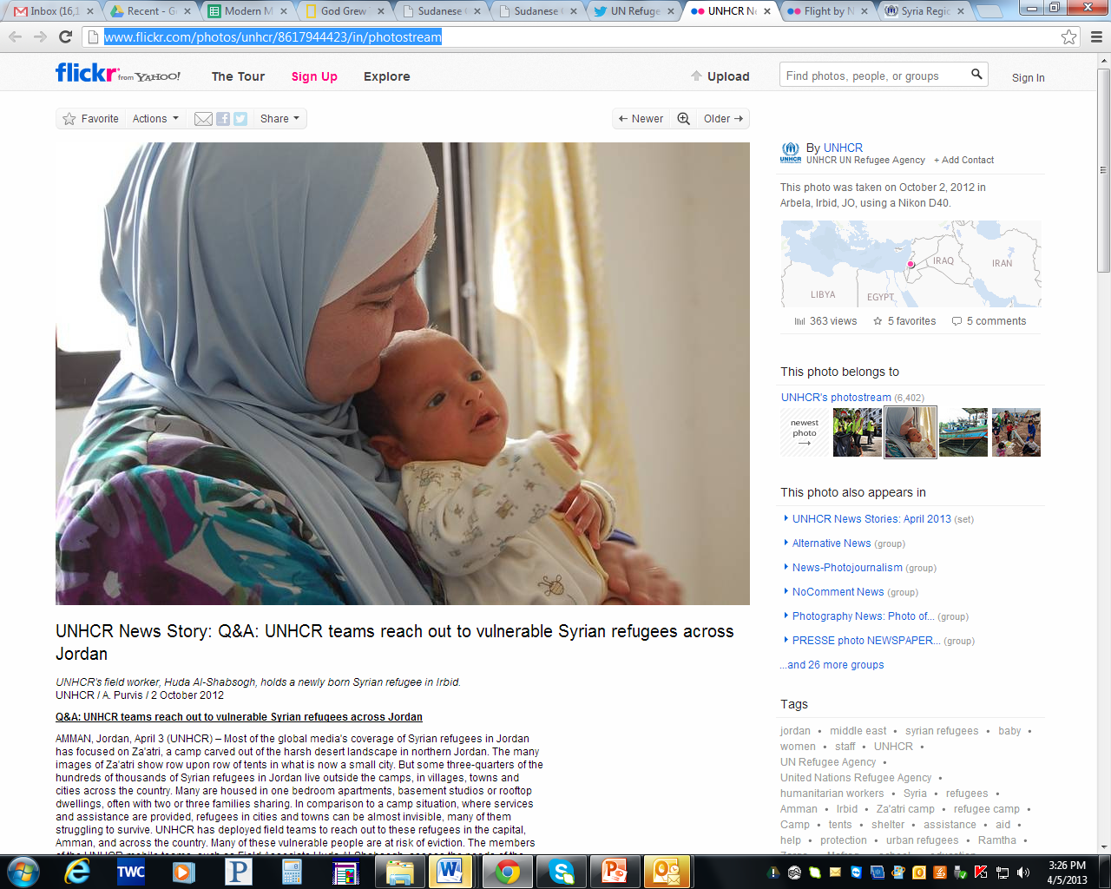
Current Refugee Crises
http://www.flickr.com/photos/unhcr/8617944423/in/photostream

Slide 29
Current U.S. Immigration Policy

Slide 30
U.S. Immigration Policy OVER TIME
http://www.msnbc.msn.com/id/34445655/ns/politics-capitol_hill
Notes:
John

Slide 31
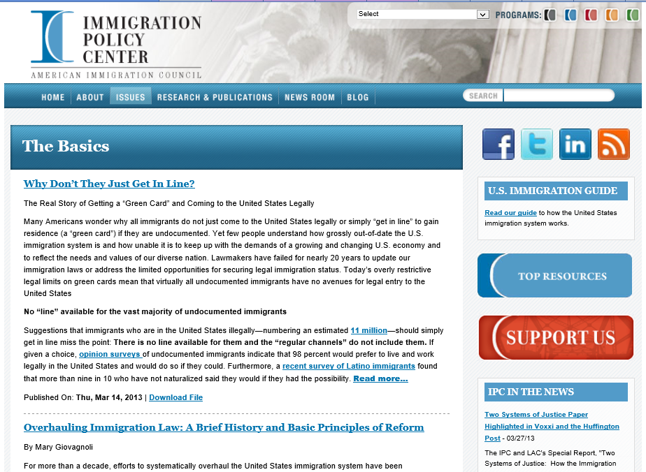
Summary of Current U.S. Immigration Policy
http://www.immigrationpolicy.org/issues/basics
Notes:
John

Slide 32
STATE VS. FEDERAL POLICY
http://latimesblogs.latimes.com/washington/2010/05/full-text-arizona-illegal-immigration-law-jan-brewer.html
Notes:
John

